Slide 1
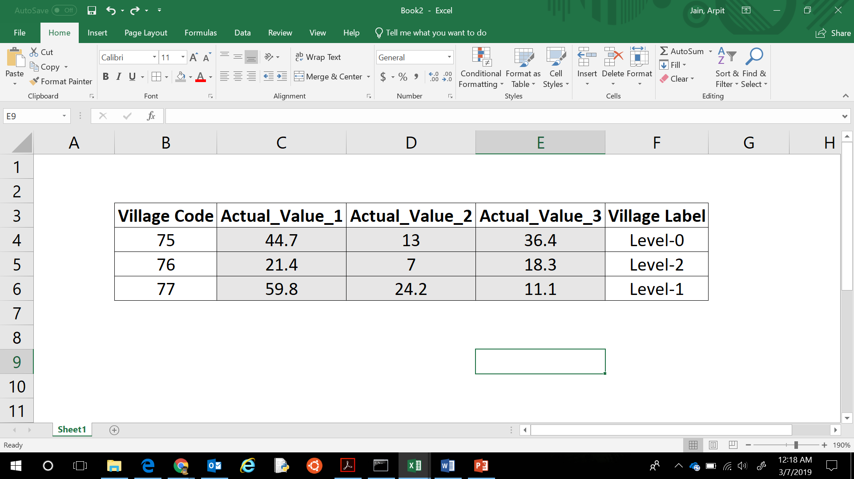
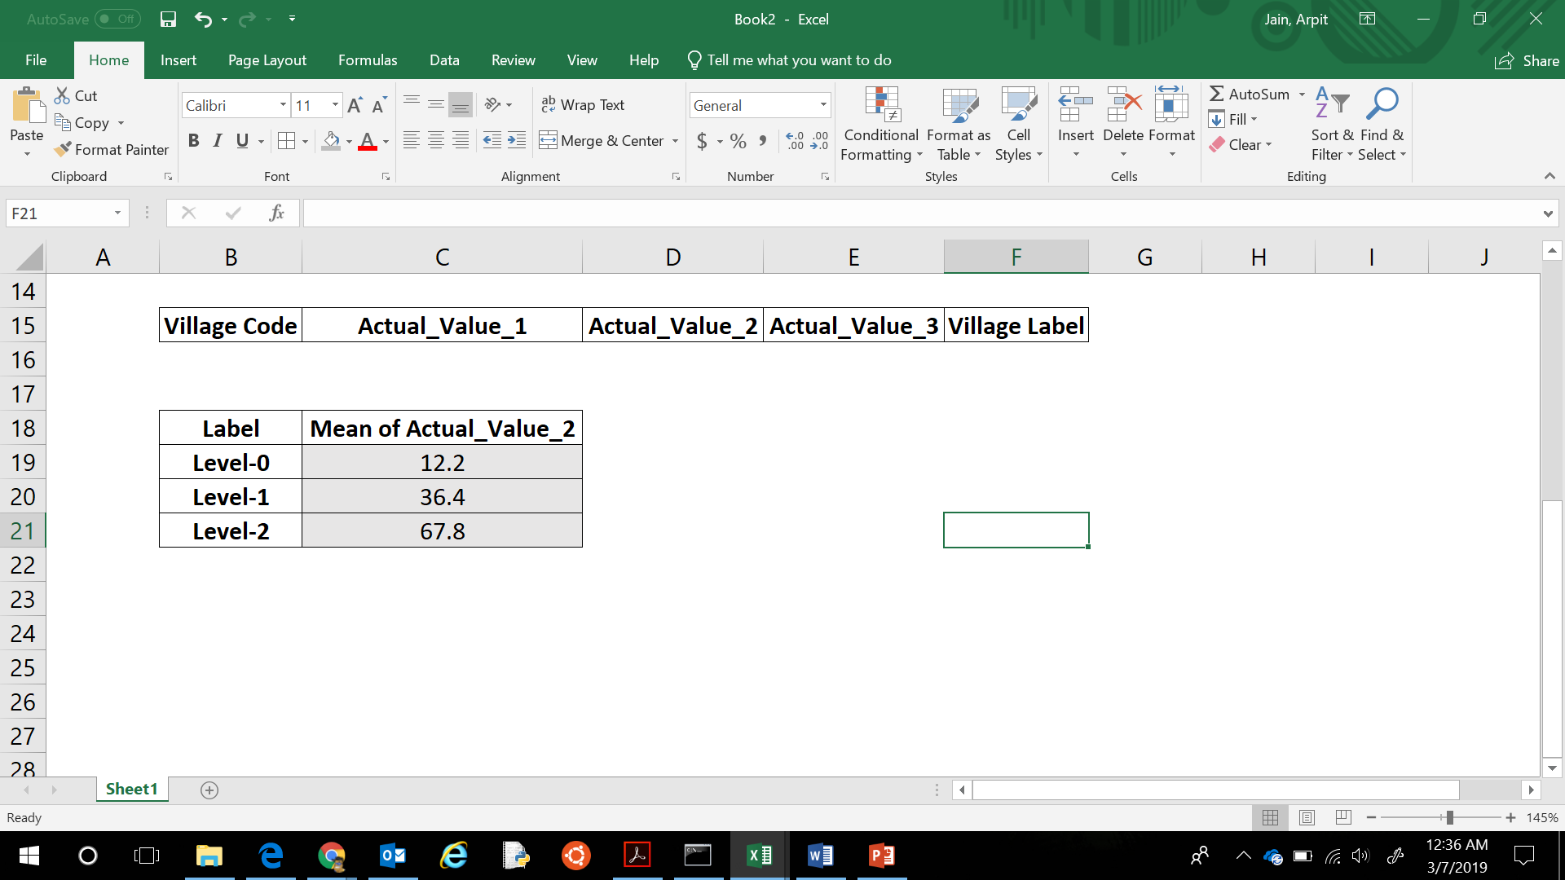
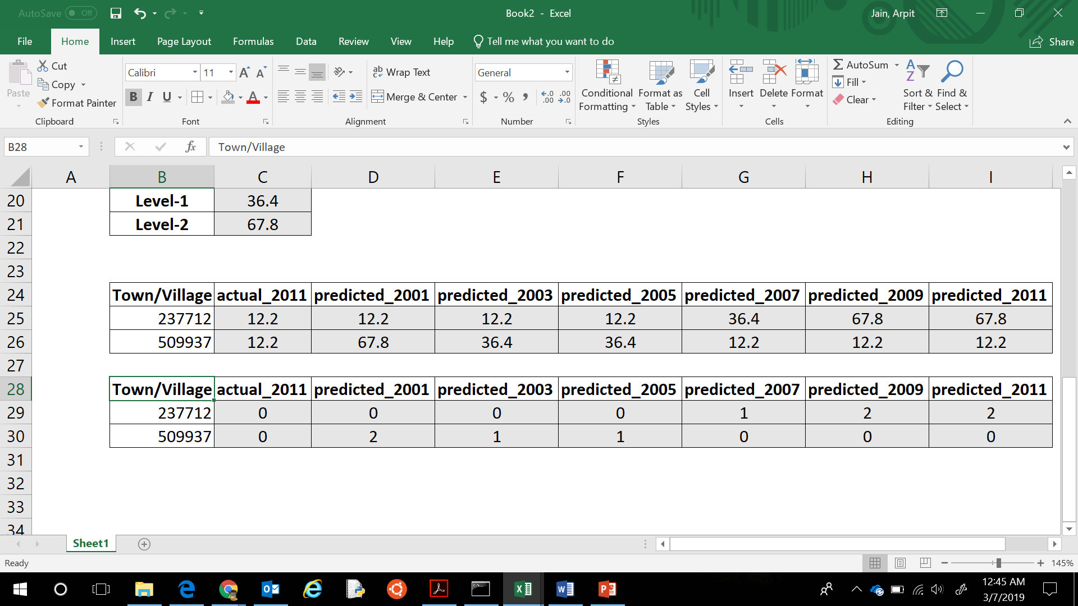
Features
Labels
Most important (Actual_Value_2)
feature
Level-0
12.2
Level-1
36.4
Level-2
67.8

Slide 2
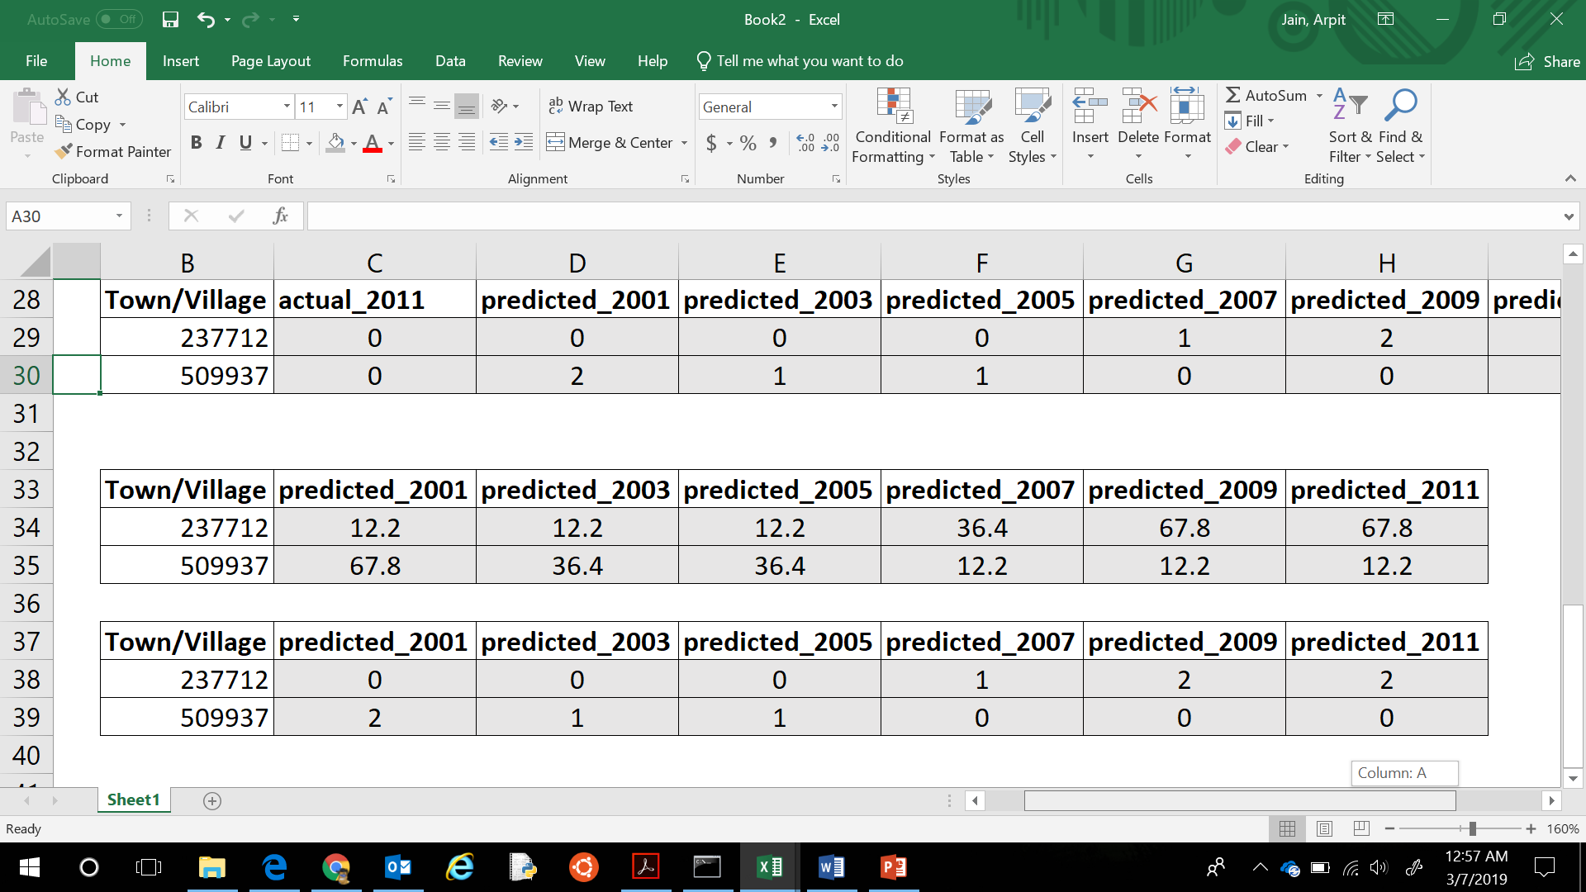
Features
Labels
Most important (Actual_Value_2)
feature
Level-0
12.2
Level-1
36.4
Level-2
67.8

Slide 3
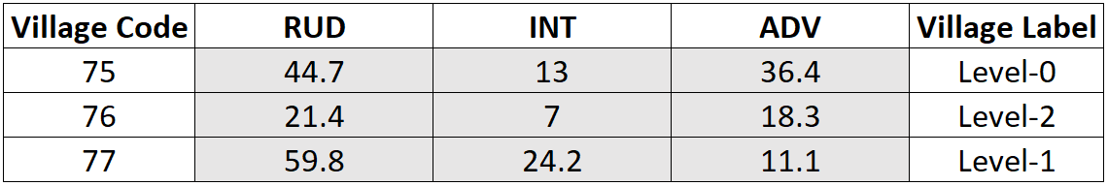
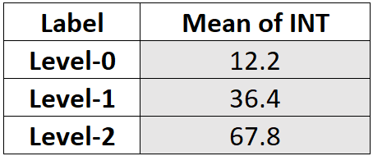
Features
Labels
Most important INT
feature
Level-0
12.2
Level-1
36.4
Level-2
67.8

Slide 6
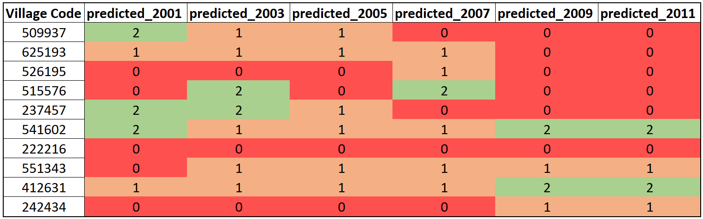
INCONSISTENCY
CONSISTENCY

Slide 7
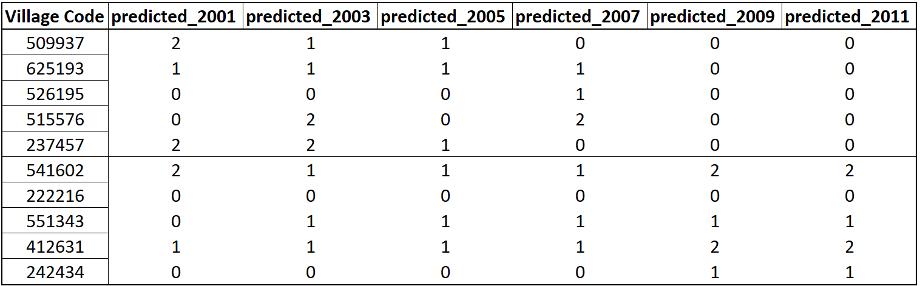
INCONSISTENCY
CONSISTENCY

